Slide 1
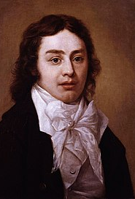
Samuel Taylor Coleridge
(Week-10)

Slide 2
Lifelong friends with Wordsworth, Robert Southey and Charles Lamb, the most prominent Romantic writers.
Lake poets*: Coleridge, Wordsworth and Southey
In his early life he had radical views in religion, politics supported French revolution and republicanism, later he became a conservative and Anglican in religion.
Went to Germany with Wordsworth studied German philosophers
Addicted to opium (as a source of poetic inspiration)
Biographia Literaria, The Rime of the Ancient Mariner, Dejection: An Ode, Kubla Khan, Christabel, Frost At Midnight
*Taylor Swift’s «The Lakes»

Slide 3
The Supernatural, the Romance, and Psychological Extremes
In most of his poems, Coleridge, like Wordsworth, dealt with everyday things, and in "Frost at Midnight" he showed how well he too could achieve the effect of wonder in the familiar (1).
However, Coleridge tells us in Biographia Literaria that his assignment was to achieve wonder by a frank violation of natural laws and of the ordinary course of events.
In his poems "the incidents and agents were to be, in part at least, supernatural.» (2) And in The Rime of the Ancient Mariner, Christahel, and "Kubla Khan," Coleridge opened up to modern poetry a realm of mystery and magic.
Stories of bewitchings, hauntings, and possession (3)—-shaped by antiquated treatises on demonology, folklore, and Gothic novels—supplied him with the means of impressing upon readers a sense of occult powers and unknown modes of being.
Nature is not the only subject matter in his poetry. The psychology of the characters is alluring topic for him as much as the nature is.

Slide 4
Cynicism towards the society
By the end of the period, printing presses were driven by steam engines, and the manufacture of paper had been mechanized; publishers had mastered publicity, the art (as it was called) of "the puff.»
Surveying the consequences of these changes, Coleridge muttered darkly about that "misgrowth," "a Reading Public," making it sound like something freakish.

Slide 5
Language must be sophisticated and elevated.
The language of poetry comes from imagination.
Poet tranlates how he perceives the World for everyone
Poet must be educated person

Slide 6
Coleridge Vs Wordsworth
Eloborated language
Supernatural, extraordinary and mysterious elements that can be found in human nature.
Poetry is to give pleasure with each part.
A poem is a composition which is opposed to works of science by its object.
simple language
Rustic and common life
Poetry is to spread humanitanal values
Spontenous overflow of powerful feelings recollected in tranquility.

Slide 7
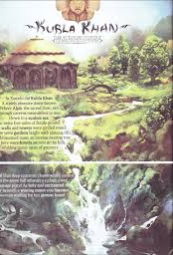
Kubla Khan
O r , A Vision in a Dream. A Fragment
In Xanadu did Kubla Khan
A stately pleasure-dome decree:
Where Alph, the sacred river, ran
Through caverns measureless to man
Down to a sunless sea.
So twice five miles of fertile ground
With walls and towers were girdled round:
And there were gardens bright with sinuous rills
Where blossomed many an incense-bearing tree;
And here were forests ancient as the hills,
Enfolding sunny spots of greenery.

Slide 8
But oh! that deep romantic chasm which slanted
Down the green hill athwart a cedarn cover!
A savage place! as holy and enchanted
is As e'er beneath a waning moon was haunted
By woman wailing for her demon-lover!
And from this chasm, with ceaseless turmoil seething,
As if this earth in fast thick pants were breathing,
A mighty fountain momently was forced:
Amid whose swift half-intermitted burst
Huge fragments vaulted like rebounding hail,
Or chaffy grain beneath the thresher's flail:
And 'mid these dancing rocks at once and ever
It flung up momently the sacred river.
Five miles meandering with a mazy motion
Through wood and dale the sacred river ran,
T h e n reached the caverns measureless to man,
And sank in tumult to a lifeless ocean:
And 'mid this tumult Kubla heard from far
30 Ancestral voices prophesying war!

Slide 9
The shadow of the dome of pleasure
Floated midway on the waves;
Where was heard the mingled measure
From the fountain and the caves.
It was a miracle of rare device,
A sunny pleasure-dome with caves of ice!

Slide 10
A damsel with a dulcimer
In a vision once I saw:
It was an Abyssinian maid,
And on her dulcimer she played,
Singing of Mount Abora.
Could I revive within me
Her symphony and song,
To such a deep delight 'twould win me,
That with music loud and long,
I would build that dome in air,
That sunny dome! those caves of ice!
And all who heard should see them there,
And all should cry, Beware! Beware!
His flashing eyes, his floating hair!
Weave a circle round him thrice,8
And close your eyes with holy dread,
For he on honey-dew hath fed,
And drunk the milk of Paradise.

Slide 11
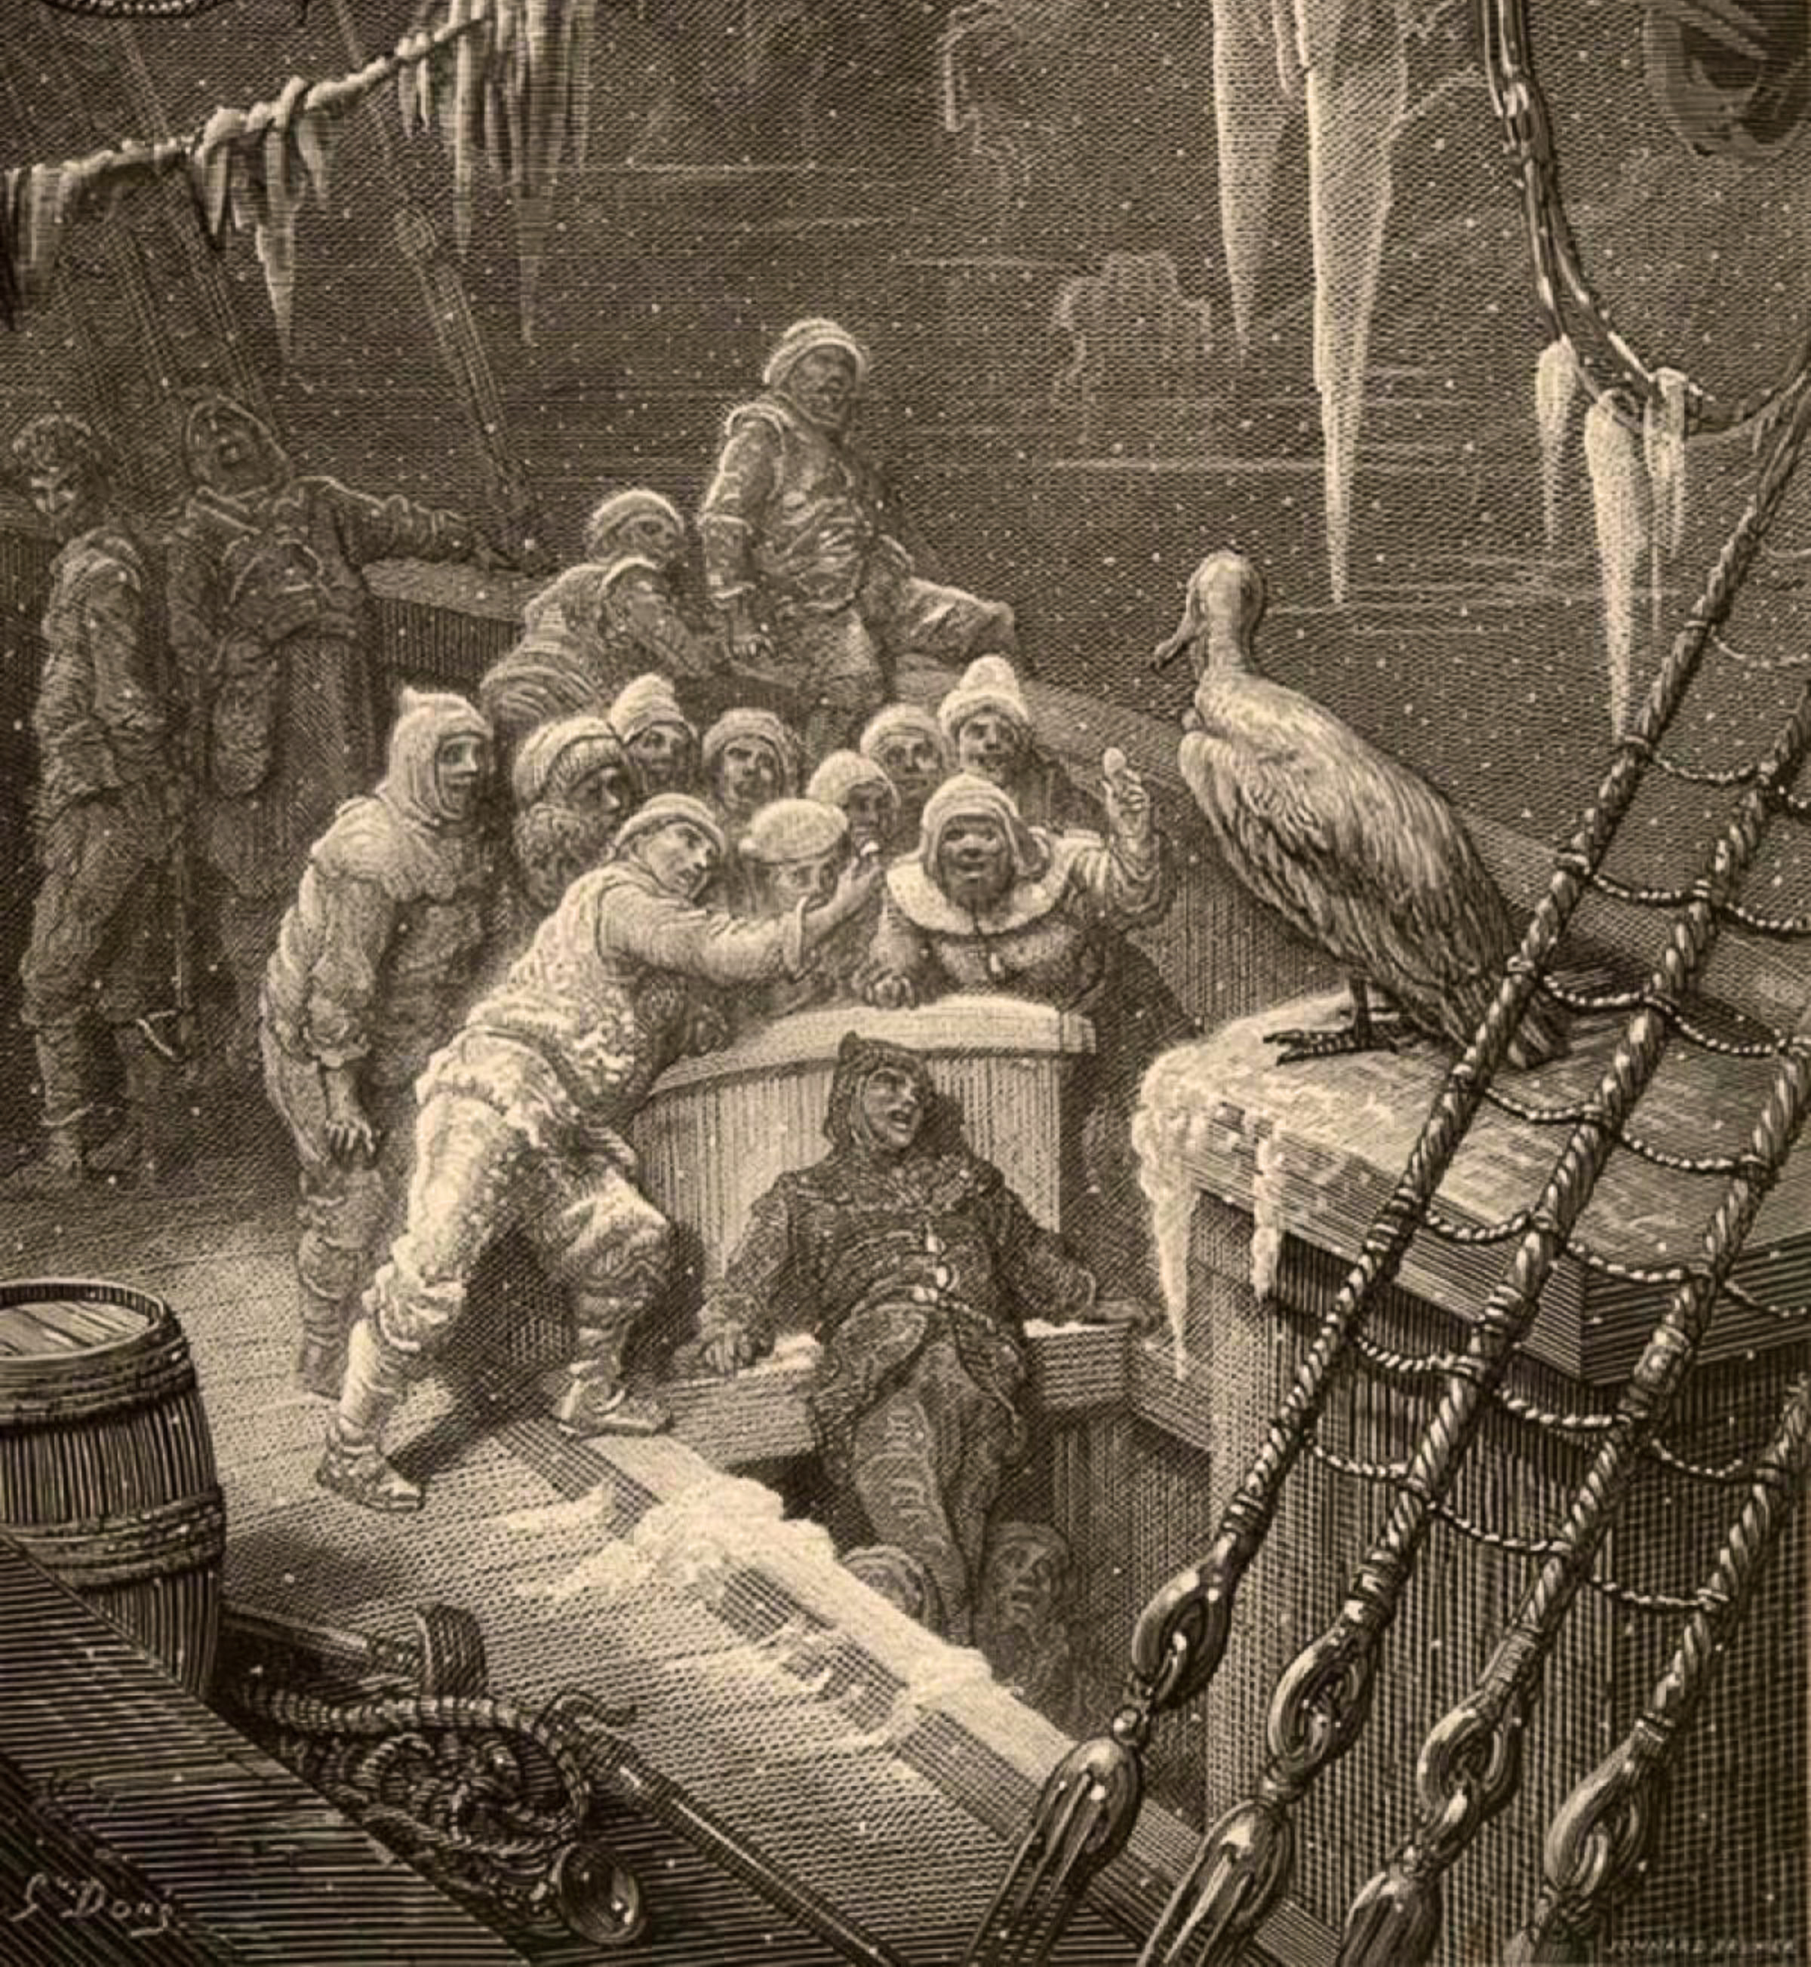
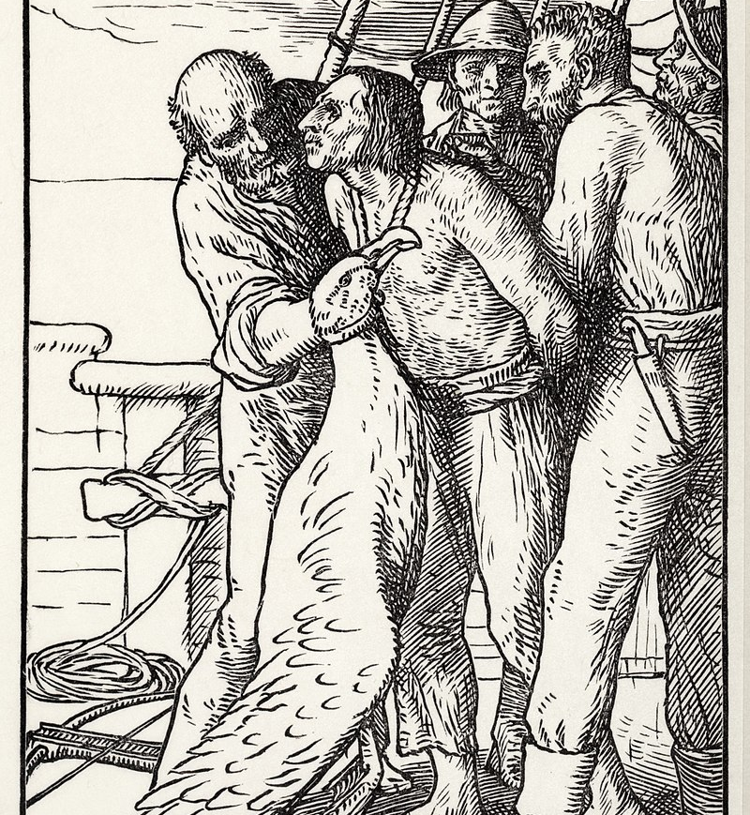
THE RIME OF THE ANCIENT MARINER

Slide 12
The Rime of the Ancient Mariner
Based on a dream of Coleridge’s friend Cruikshank.
Tells the supernatural story of a mariner
Edited several times by Coleridge
Uses various storytelling techniques throughout the poem
Nature, the supernatural, ghosts, skeletons, curse
Inexplicable events
Gothic, dead bodies, fear
Albatross as a symbol, suffering and repentance, isolation
Nature and the sea creatures, in harmony with the nature

