Slide 1
The Restoration and The 18th Century
1660-1785
Week 3 part 2

Slide 2
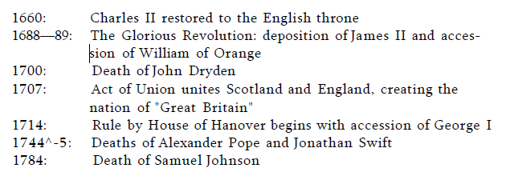

Slide 3
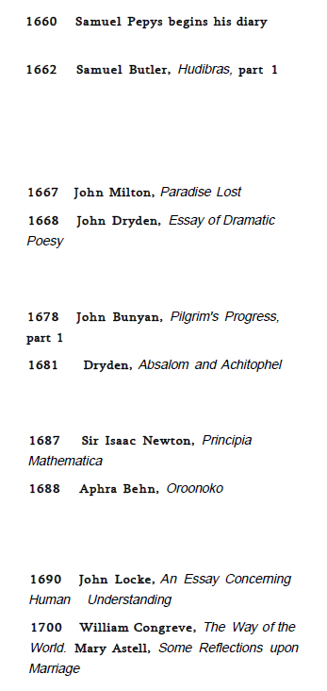
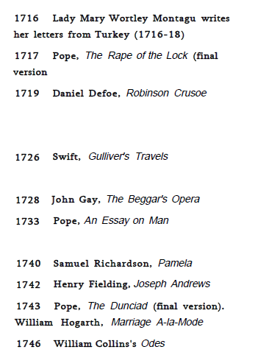
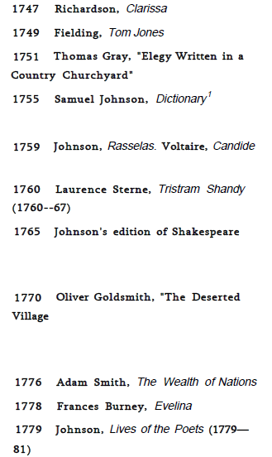

Slide 4
Literary Principles
A sudden change of taste seemed to occur around 1660. The change had been long prepared, however, by a trend in European culture, especially in seventeenth-century France: the desire for an elegant simplicity. Reacting against the difficulty and occasional extravagance of late Renaissance literature, writers and critics called for a new restraint, clarity, regularity, and good sense. Donne's "metaphysics" and Milton's bold storming of heaven, for instance, seemed overdone to some Restoration readers. Hence Dryden and Andrew Marvell both were tempted to revise Paradise Lost, smoothing away its sublime but arduous idiosyncrasies. As daring and imaginative as Dryden’s verse is, he tempers even its highly dramatic moments with an ease and sense of control definitive of the taste of his times.

Slide 5
RESTORATION LITERATURE, 1660-1700
Dryden p.126
Absalom and Achitopel, Essay of Dramatic Poesy, Medal, Macflecknoe,
Restoration Drama p.127
Age of Dryden
John Bunyan The Pilgrims Progress
Samuel Butler, Hudibras
Sir Isaac Newton, John Locke
Aphra Behn, Ooronko

Slide 6
Eighteenth Century Literature 1700-1745
Swift, Addison, Pope
Swift, Gulliver’s Travels
Alexander Pope, The Rape of the Lock, An Essay on Criticism, Dunciad, An Essay on Man
Daniel Defoe, Robinson Crusoe (1719), Moll Flanders (1722)
William Congreve, The Way of the World (1700)
Lady Mary Wortley Mantagu, Letters from Ottoman Empire
Samuel Richardson, Pamela

Slide 7
New Literary Themes and Modes 1740-1785
Samuel Johnson, Dictionary, Rasselas, Lives of Poets
The Age of Johnson
Thomas Gray, Elegy Written in a Churchyard
Henry Fielding, Tom Jones
Laurence Sterne, Tristram Shandy
Oliver Goldsmith, The Deserted Village
Adam Smith, The Wealth of Nations
James Macpherson, The Ossian

